Slide 1
abstracts of research papers
CCSW325 Software Construction
Student ID | Student Name
2242187 | Abdulsalam Ahyaf
2240297 | Abdulmajeed Abdullah
2240198 | Faisal Alghamdi
2241316 | Faisal Alqarni
2240371 | Feras Ahmad

Slide 2
Contents
Paper Number 1 | Unraveling the Potential of Large Language Models in Code Translation: How Far Are We?
Paper Number 2 | Exploring and Unleashing the Power of Large Language Models in Automated Code Translation
Paper Number 3 | TRANSAGENT: An LLM-Based Multi-Agent System for Code Translation
Paper Number 4 | Lost in Translation: A Study of Bugs Introduced by Large Language Models while Translating Code
Paper Number 5 | Towards Translating Real-World Code with LLMs: A Study of Translating to Rust

Slide 3

"Unraveling the Potential of Large Language Models in Code Translation: How Far Are We?"
This study investigates the effectiveness of Large Language Models (LLMs) in code translation, focusing on their limitations due to inadequate training on parallel multilingual code data. The authors propose a novel benchmark, PolyHumanEval, which includes 14 programming languages to provide a comprehensive framework for evaluating LLM performance in code translation. The research aims to uncover the capabilities and limitations of LLMs in translating code between different programming languages.

Slide 4
Dataset & Evaluation Metrics
Dataset
Evaluation Metrics
The dataset was created through a meticulous process that involved:
1-Handcrafting solutions for each programming problem.
2-Validating each solution through peer reviews and extensive testing to ensure correctness
and semantic alignment.
3-Employing a rule-based tool to automatically generate equivalent test programs across all
selected languages, ensuring accuracy and consistency.
Benchmarking: The PolyHumanEval benchmark was developed by extending the existing HumanEval dataset to include 14 programming languages
Experimental Setup: The study evaluated multiple LLMs, including CodeLlama (7B, 13B, and 34B) and StarCoder, across 26 translation tasks.
Prompt Designs: Different prompt configurations were tested to enhance translation effectiveness.

Slide 5
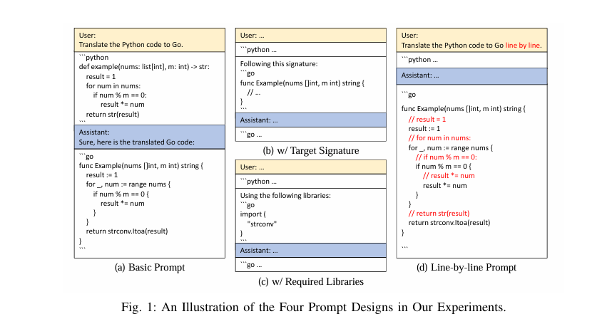
Four Prompt Design

Slide 6
Results
LLMs demonstrated higher computational accuracy when translating code into Python, achieving an average CA score of 86.16 for translations to Python, while the score dropped to 66.93 for translations from Python to other languages.
The intermediary translation method utilizing Go showed significant improvements in translation accuracy, validating its role as an effective lingua franca for code translation tasks.
Self-training methods led to substantial optimization, with verified self-generated datasets improving performance across both targeted and broader translation tasks.
The results also indicated that prompt designs significantly affected translation effectiveness, with prompts that included target function signatures yielding better performance.

Slide 7
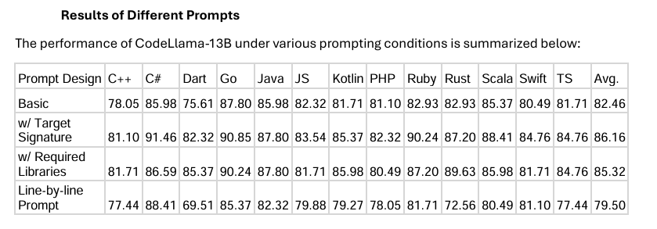
Results of Different Prompts

Slide 8
Main Idea
This research investigates the possibilities of Large Language Models (LLMs), traditional code translation tools, or transpilers, have limitations with regard to correctness and practical deployment. The study examines how well LLMs succeed in getting over these restrictions and suggests a brand-new framework named UniTrans to improve the caliber of code translation.

Slide 9
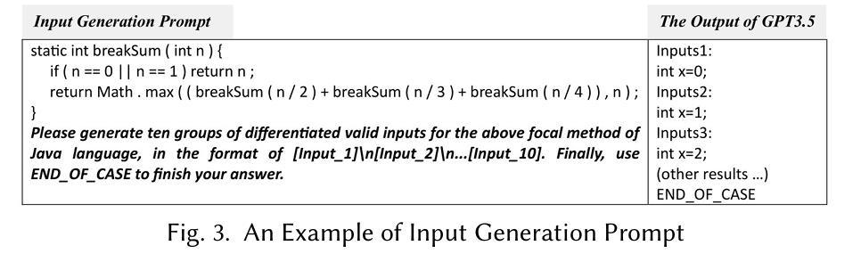
Methodology
1 - Test Case Generation Phase
"${progsrc} \nPlease generate ten groups of differentiated valid inputs for the above focal method of ${plsrc} language, in the format of [Input_1]\\n[Input_2]\\n ... [Input_10]. Finally, use END_OF_CASE to finish your answer."

Slide 10
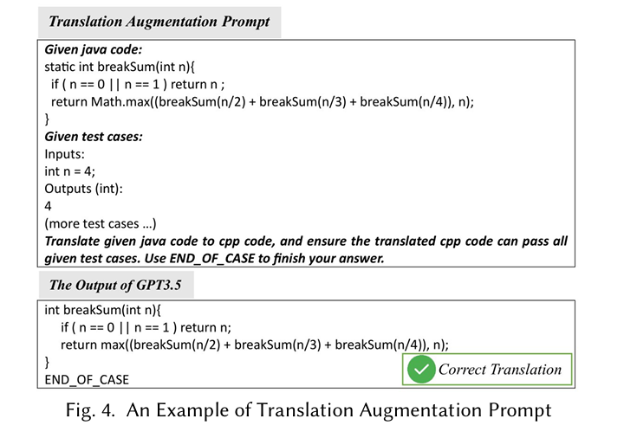
Methodology
"Given ${plsrc} code:\n${progsrc}\nGiven test cases:${TCtar}\nTranslate given ${plsrc} code to ${pltar} code, and ensure the translated ${pltar} code can pass all given test cases. Use END_OF_CASE to finish your answer."
2 - Translation Augmentation Phase

Slide 11
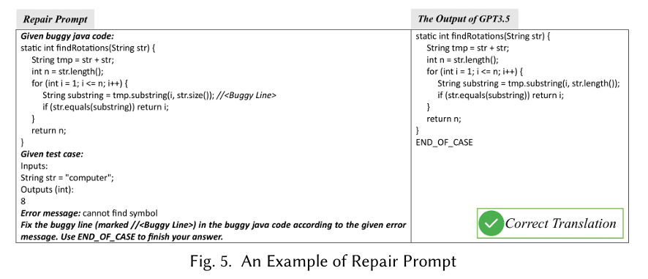
Methodology
"Given buggy ${pltar} code:\n${progtar}\nGiven test case:${tc*}\nError message: ${err_msg}\nFix the buggy line (marked ${com_symtar} <Buggy Line>) in the buggy ${pltar} code according to the given error message. Use END_OF_CASE to finish your answer."
3 - Translation Repair Phase

Slide 12
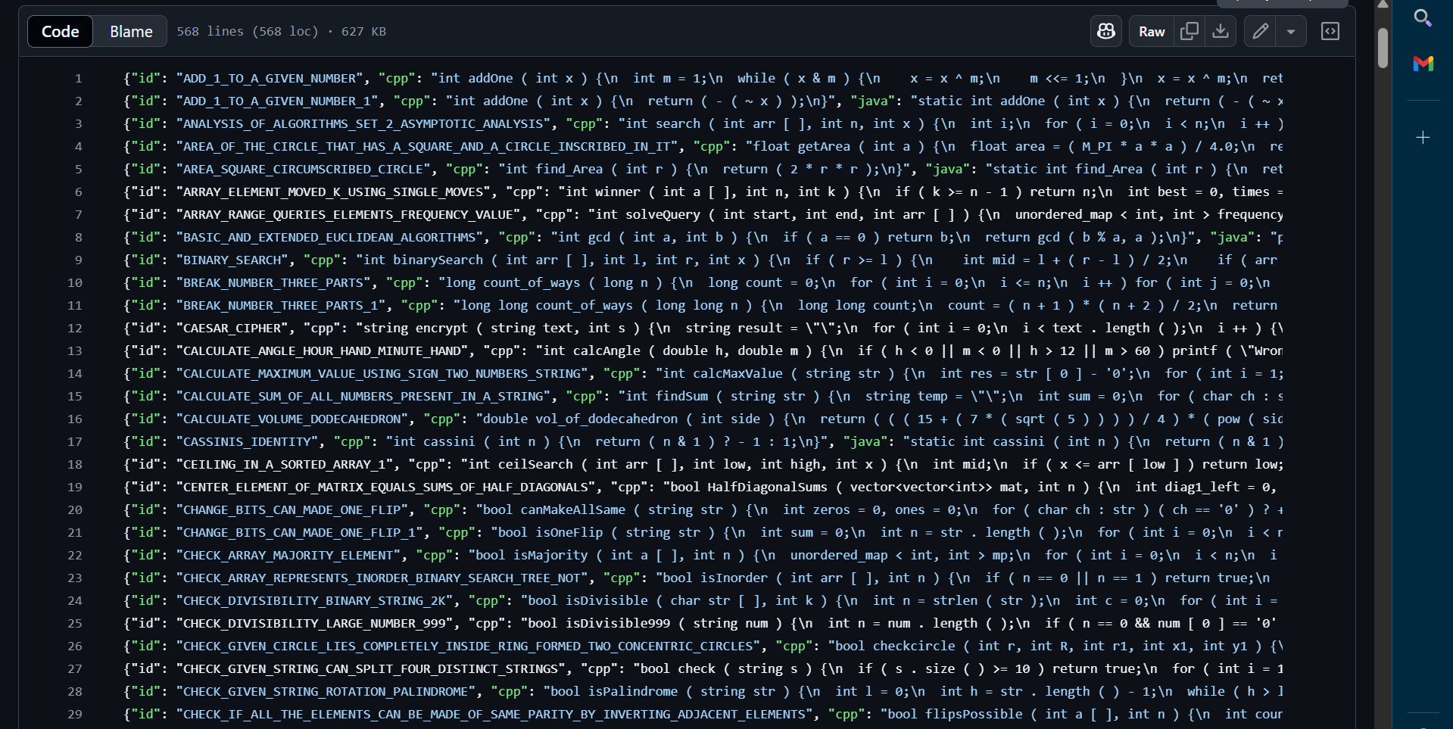
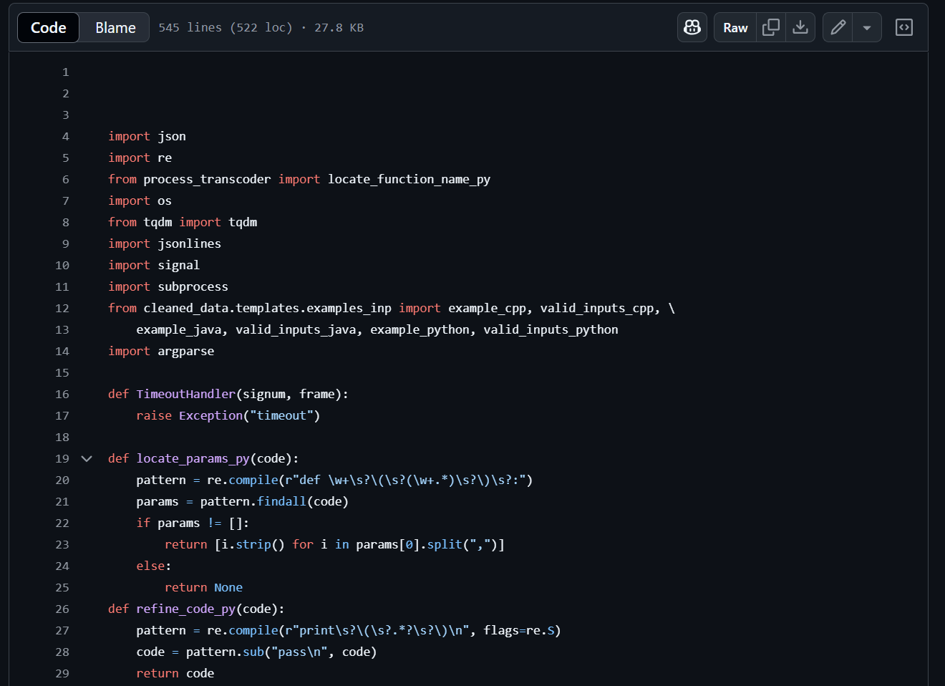
Dataset
Data Cleaning
Test Case Generation Phase

Slide 13
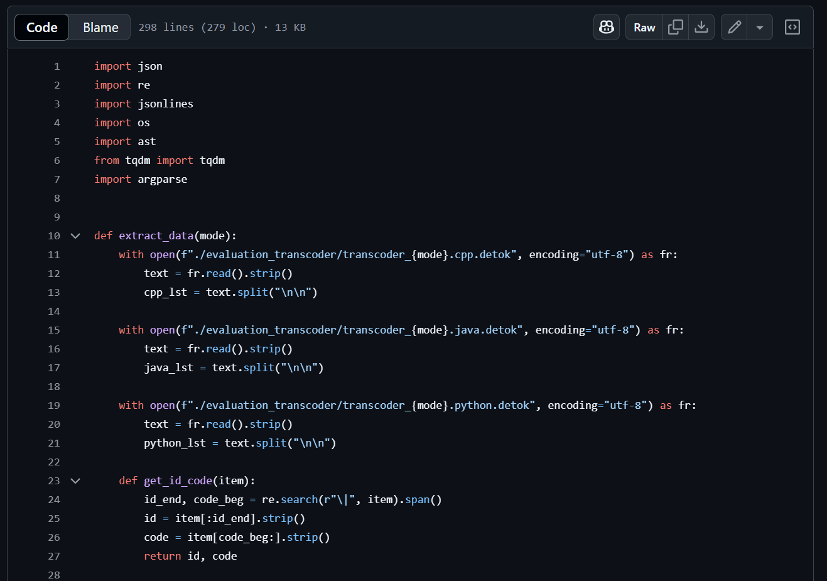
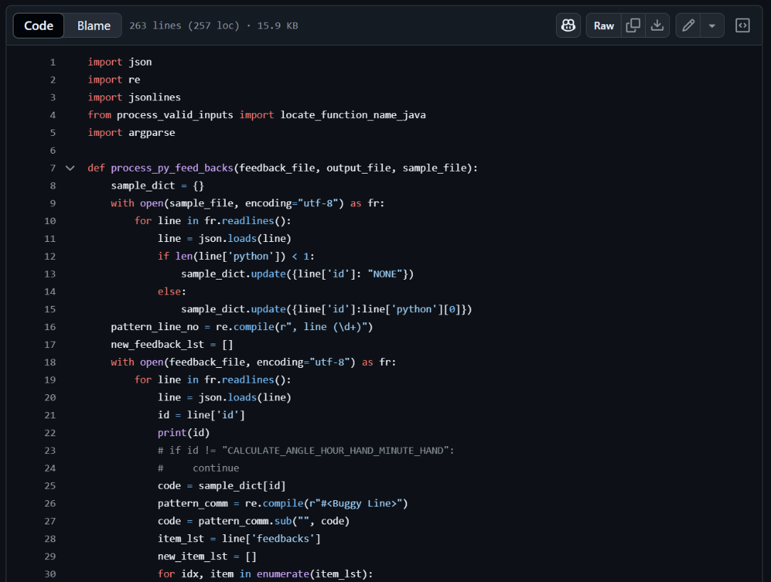
Dataset
Translation Repair Phase
Translation Augmentation Phase

Slide 14
Evaluation Metrics
Execution Match Accuracy (EM Acc)
Correctness Accuracy (CA)
Precision (PR)

Slide 15
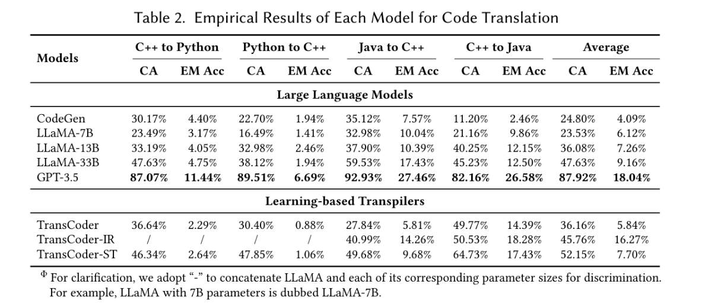
Results
Performance of LLMs:

Slide 16
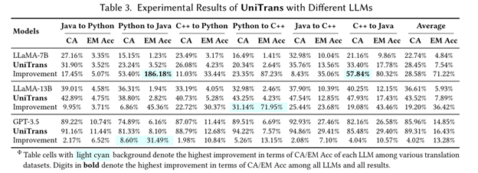
Results
Effectiveness of UniTrans:

Slide 17
TRANSAGENT: An LLM-Based Multi-Agent System for Code Translation
Authors: Zhiqiang Yuan, Weitong Chen, Hanlin Wang, Kai Yu, Xin Peng, & Yiling Lou
Affiliation: Fudan University, China Abstract Code translation converts code from one programming language to another while maintaining its original functionality, which is crucial for software migration, system refactoring, and cross-platform development.

Slide 18
Problem Statment
Challenges in Code Translation:
Rule-based methods: Manually intensive, low readability.
Learning-based models: Require extensive training data, costly to train.
LLMs: Produce syntax errors, semantic inconsistencies, and debugging difficulties.
Need for a structured, iterative refinement process.

Slide 19
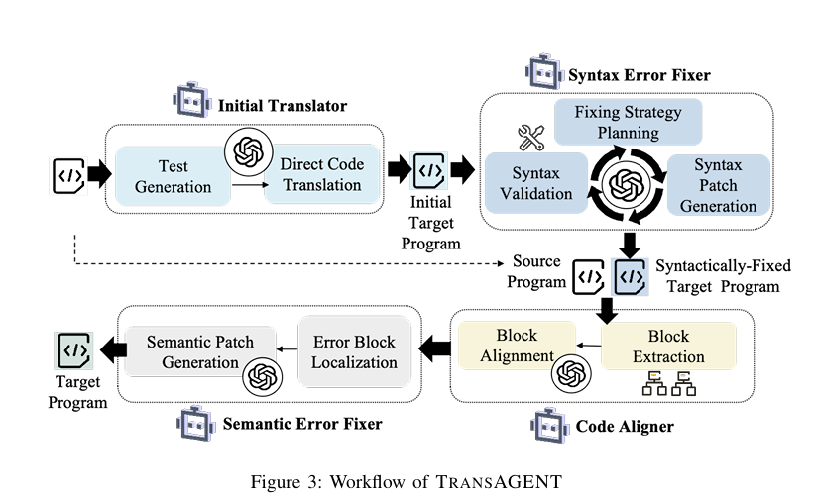
Methodology – TRANSAGENT Multi-Agent System

Slide 20
Results and Performance
Outperforms UniTrans & TransCoder in accuracy:
Python-to-Java CA improved by 33.3%.
Code mapping accuracy increased by 39.6% over TransMap.
More cost-effective:
Requires 19s per example (vs. 24s for UniTrans).
Generalizes well across different LLMs.

Slide 21
Conclusion & Future Work
Key Takeaways:
TRANSAGENT improves translation accuracy and efficiency.
Multi-agent approach effectively refines LLM-based translations.
Code alignment and execution-based error correction reduce functional discrepancies.
Future Work:
Extend to more programming languages.
Optimize computation costs for real-world applications.

Slide 22
Main Idea
The study investigates the effectiveness and limitations of Large Language Models (LLMs) in translating code between different programming languages. It aims to understand the bugs introduced during this translation process and proposes methods to improve LLM performance through enhanced prompting techniques.

Slide 23
Methodology
Empirical Study
Bug Taxonomy
Prompt-Crafting Approach
The research involves a large-scale empirical study, translating 1,700 code samples across five programming languages: C, C++, Go, Java, and Python.
A new approach is proposed that enhances contextual information provided to the LLMs during translation, aiming to reduce errors.
The authors categorize translation failures into 15 distinct types, analyzing the root causes of these bugs

Slide 24
Dataset & Evaluation Metrics
Dataset
Evaluation Metrics
The dataset is designed to provide a comprehensive resource for evaluating the performance of LLMs in code translation tasks, particularly focusing on the introduction of bugs during translation.
These evaluation metrics collectively provide a robust framework for assessing the performance of LLMs in translating code. By focusing on correctness, error types, and the impact of prompting strategies, the study offers valuable insights into both the capabilities and limitations of current LLM approaches in the realm of code translation.

Slide 25
Dataset Overview
Composition
Characteristics
Sources
The dataset consists of 1,700 executable code samples. It covers five programming languages: C, C++, Go, Java, and Python
The dataset includes over 10,000 tests designed to evaluate the functionality and correctness of the code.
It features 43,000+ translated code snippets, ensuring a diverse range of examples for translation tasks.
Benchmarks:1-CodeNet
2-Avatar 3- EvalPlus
Real-World Projects:
1-Apache Commons CLI
2-Python Click

Slide 26
Evaluation Metrics
Correctness Rate
Type and Frequency of Bugs
Prompt Effectiveness
1-Compile successfully.
2-Pass runtime checks.
3-Successfully execute all relevant tests.
The effectiveness of the proposed prompt-crafting technique is measured by comparing the success rates of translations before and after implementing the new prompting strategies. This provides insight into how contextual information impacts translation accuracy.
The evaluation also includes
metrics related to the type and
frequency of identified bugs. By
analyzing how often different
types of bugs occur, the study can
identify common pitfalls in LLM
translations

Slide 27
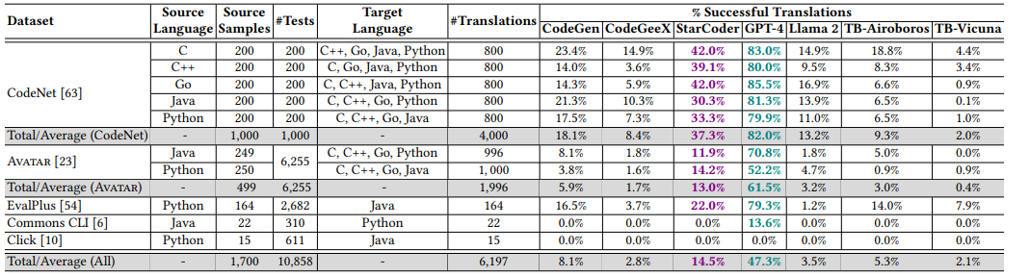
Results

Slide 28
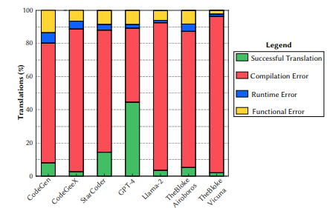
Stacked bar graph

Slide 29
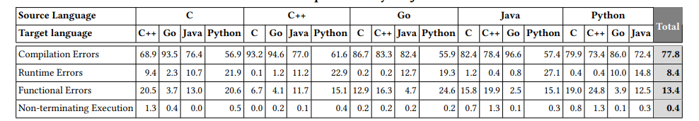
Results

Slide 30
Towards Translating Real-World Code with LLMs: A Study of Translating to Rust
The study investigates the effectiveness of large language models (LLMs) in translating real-world code into Rust. It focuses on assessing the capabilities of five state-of-the-art LLMs—GPT-4, Claude 3, Claude 2.1, Gemini Pro, and Mixtral—highlighting the challenges and methodologies for achieving accurate and idiomatic translations.

Slide 31
Methodology
Tool Development
The authors developed FLOURINE, an end-to-end code translation tool capable of producing validated Rust translations

Slide 32
Dataset
Dataset
The study utilized code samples extracted from seven open-source projects written in C and Go.

Slide 33
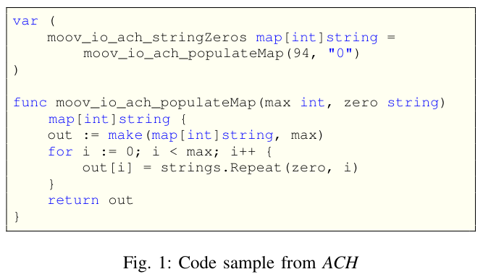
Datasets
1. ACH
2. geo
3. libopenaptx
Go library implementing a reader, writer, and validator for banking operations.
Go library implementing common geometry functions and interval arithmetic.
C library for audio processing.
4. opl
C library for sound card emulation

Slide 34
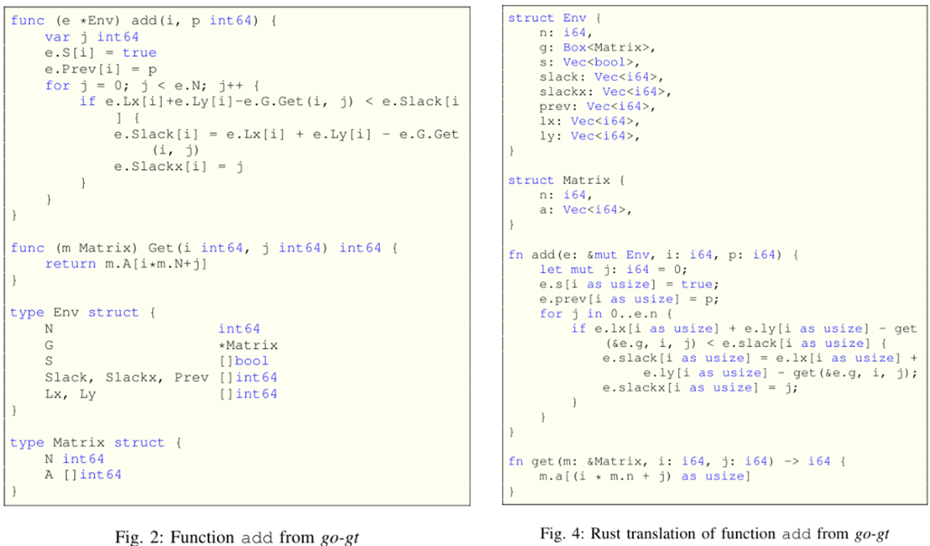
Datasets
5. go-gt
Go library for graph algorithms.

Slide 35
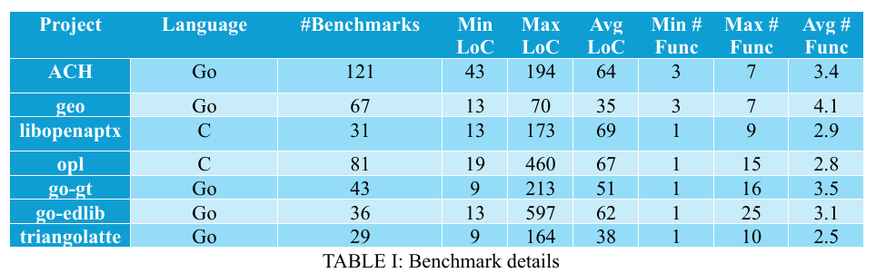
Datasets
6. go-edlib
7. triangolatte
Go library for string comparison and edit distance algorithms.
Go library for 2D triangulation.

Slide 36
Evaluation Metrics
Feedback Strategy Effectiveness
Translation Success Rate
The percentage of successfully translated benchmarks that compile and pass the fuzzing tests.
Comparison of initial and final success rates when using various feedback strategies.
Linter Warnings
Analysis of idiomatic usage in the generated Rust code, evaluated using Clippy, Rust's linter.

Slide 37
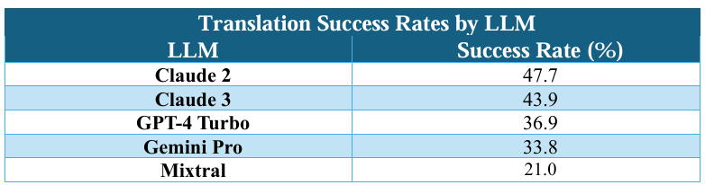
Results
• The most successful LLM, Claude 2, achieved a translation success rate of 47%.
• Overall, LLMs achieved success rates ranging from 21% to 47% across 8160 code translation experiments.

